Slide 1
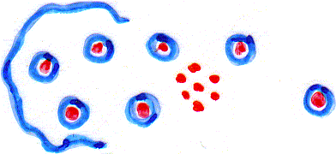
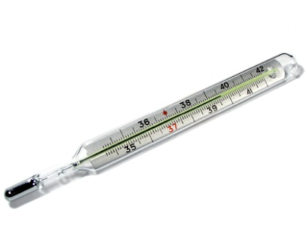
Pathogenesis and Clinical Picture
Incubation period followed by influenza-like symptoms.
Malaria paroxysm (clinical attack):
Coincides with:
- Rupture of infected and uninfected RBCs.
Haemozoin
- Release of parasite metabolites.
- Host immunologic response.
Includes:
Metabolites
- Cold stage
Lasts about 30 min.
- Hot stage
Lasts 1-4 hours
- Sweating stage
Lasts for hours

Slide 2
Pathogenesis and Clinical Picture
Recurrence of clinical attack is called:
Relapse (in P.vivax and P.ovale infection)
due to presence of hypnozoites in the liver.
Recrudescence (in P.malariae and P.falciparum infection)
due to persistent low-grade parasitaemia.
Anaemia: haemolytic anaemia
Plasmodium parasite invades:
- Reticulocytes only (in P.vivax and P.ovale).
Restricted anaemia
- Old RBCs only (in P.malariae).
- RBCs at any age (in P.falciparum).
Severe anaemia

Slide 3
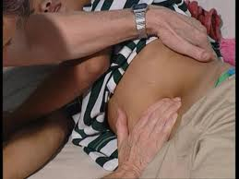
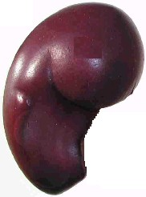
Pathogenesis and Clinical Picture
Enlargement of liver and spleen.
occurs due to enhanced phagocytosis of remnants of ruptured red cells and debris of schizont.
Remnants

Slide 4
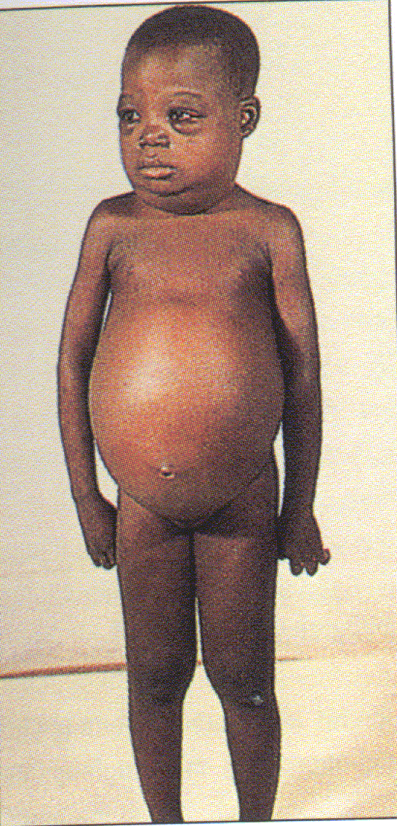
Complications
Vivax, ovale & malariae malaria
Relatively benign.
Chronic malariae malaria
Nephrotic syndrome.
Parasite produces increased amount of antigens.
Blood protein
Immune system produces increased amount of antibodies.
Antigens attach to antibodies producing
immune-complex in blood.
Immune-complexes are deposited on the glomerular walls activating the complement
Protein in urine
Tissue damage.
C1,
4,
2,
3,
5,
6,
7,
8,
9
MAC
Child has nephrotic syndrome

Slide 5
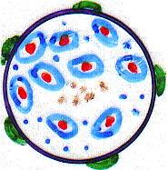
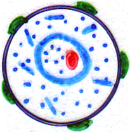
Complications of falciparum malaria
1- Knobs develop on surface of infected RBCs
Knobs are parasite antigens expressed on the surface of infected red cells containing trophozoites and schizont stages.
They adhere to receptors found on endothelium of blood capillaries of internal organs blood supply
anoxia and necrosis.
Normal RBC
Infected RBC

Slide 6
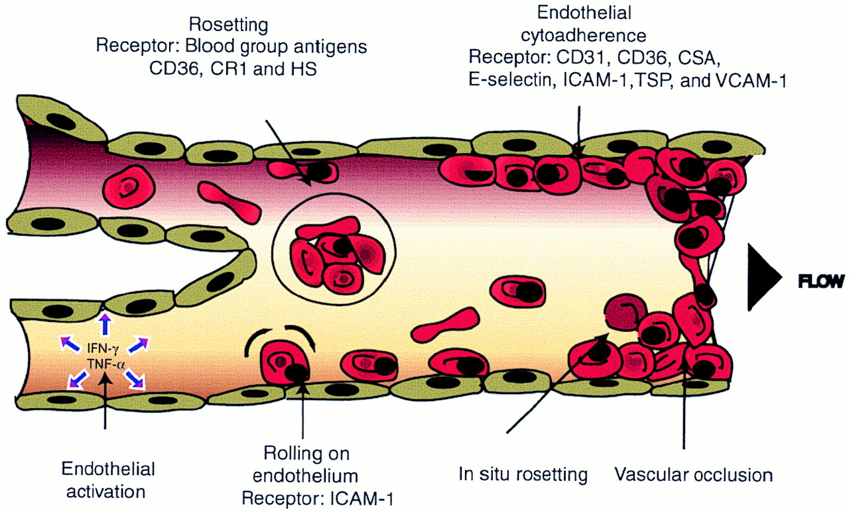
Malaria – Cytoadherence Phenomena
Cytoadherence and rosetting in postcapillary vasculature.
Chen Q et al. Clin. Microbiol. Rev. 2000;13:439-450
Parasitised R.B.C.s express a specific surface antigen which adheres to specific receptors on the endothelial cell surface of capillaries of vital organs give rise to Cytoadherence (phenomenon) which leads to Sequestration (gathering) of parasitized and non parasitized erythrocytes localized capillary obstruction & massive intravascular haemorrhage decreased blood flow Tissue anoxia & Necrosis (infarction) Oedema & Haemorrhage of vital organs

Slide 7
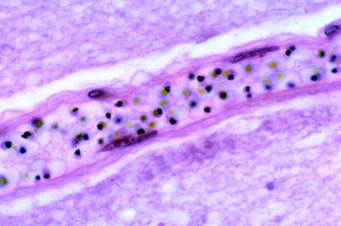
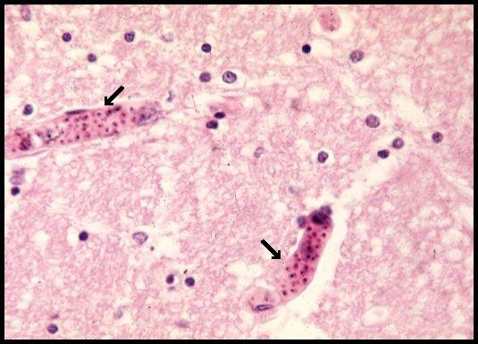
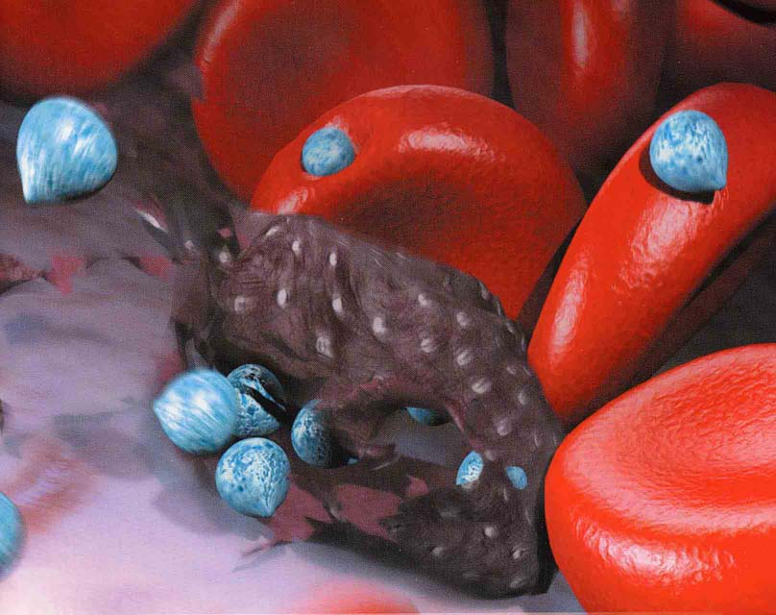
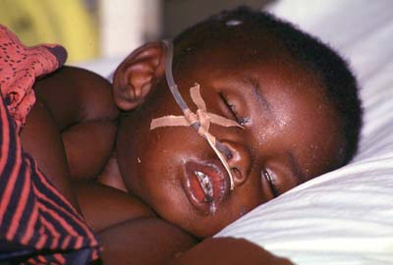
Malaria - Cytoadherence

Slide 8
Complications of falciparum malaria
In brain : cerebral malaria.
In GIT : ischemia in capillary bed of intestinal wall.
In the lung : blood flow in pulmonary circulation.
In Circulation : algid malaria.
In liver : impaired gluconeogenesis
In the kidney : acute renal failure.
Headache, drowsiness, convulsions & coma
Diarrhea, dysentery, gastrointestinal bleeding
Pulmonary oedema, difficulty in breathing
Decreased temperature, Hypotension, circulatory collapse & Shock
Hypoglycemia

Slide 9
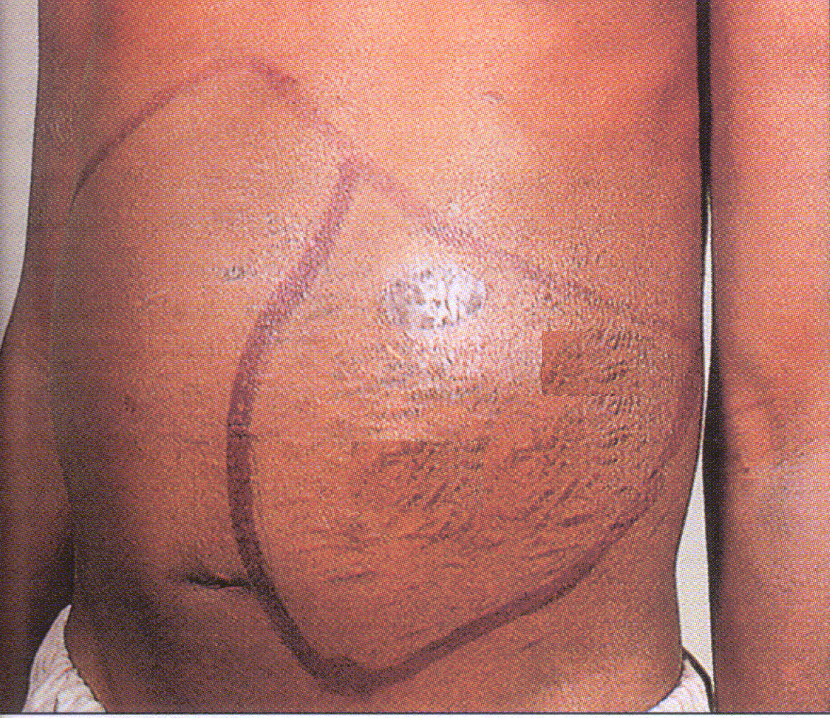
Complications of falciparum malaria
2- Hyper-reactive malarial splenomegaly
The spleen is markedly enlarged with increased IgM production. This is due to reduction of T-suppressor cells that control B-cell activation. (Tropical Splenomegaly syndrome)(TSS)
3- Black water fever
Occurs: when?
- Repeated attacks of P.falciparum infection.
- Incomplete quinine therapy.
Pathogenesis
Massive intravascular haemolysis occurs
producing:
Anaemia, haemoglobinuria, jaundice.
This is autoimmune with development of antibodies to infected red blood cells.
Cause

Slide 10
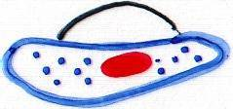
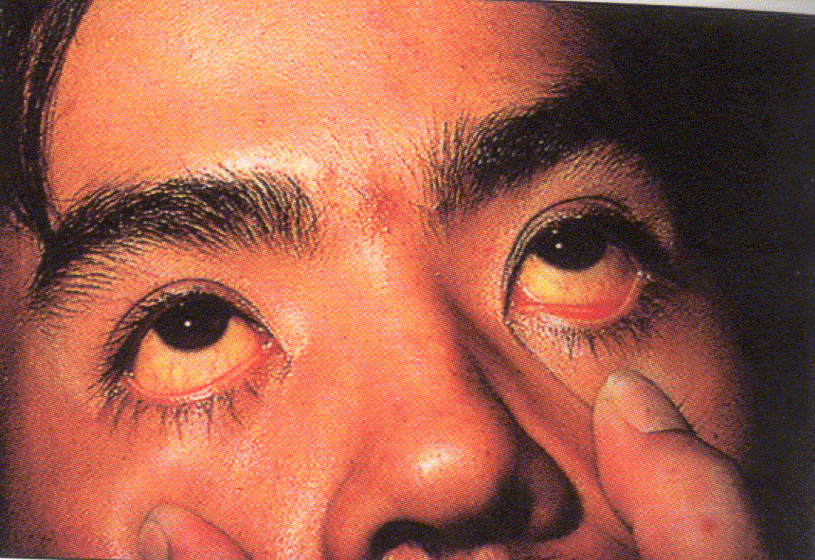
Pathogenesis of Black Water Fever
Blood Vessel of the infected patient
Auto-antibodies
Normal RBCs
Infected RBCs
Normal urine
Jaundiced patient
Haemoglobinuria

Slide 11
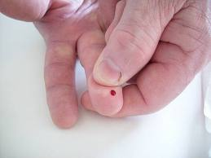
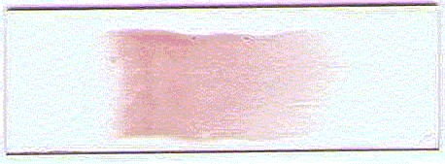
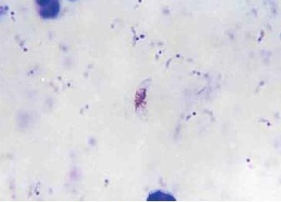
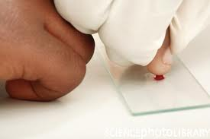
Diagnosis
1- Thin and thick blood films to demonstrate the parasite.
Thin blood film
One drop of blood spread on a slide
Finger prick
Thick blood film
4 drops of blood spread in a small circle on a slide
Giemsa stained blood films

Slide 12
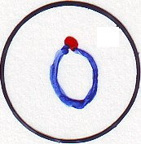
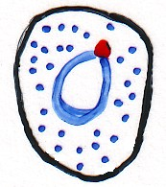
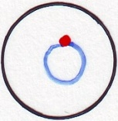
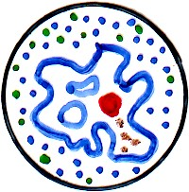
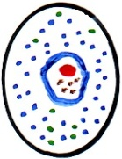
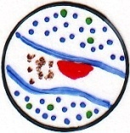
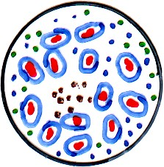
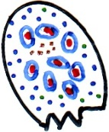
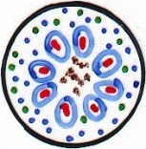
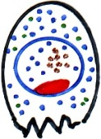
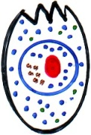
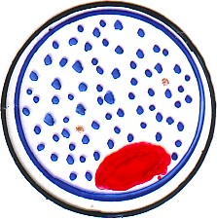
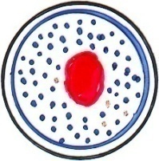
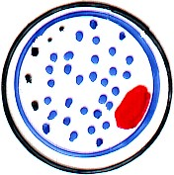
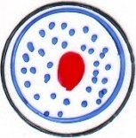
P. vivax
P. ovale
P. malariae
P. falciparum
Infected RBC
Enlarged, rounded
Enlarged, oval
Normal size & shape
Ring
Ring 1/3 RBC size
Ring 1/3 RBC size
Ring 1/3 RBC size
Ring 1/6 RBC size
Multiple rings
Malaria pigments
X
Trophozoite
Schuffner’s dots
Ziemann’s dots
Maurer’s clefts
Schizont
X
24
8
8
16
Not seen in peripheral blood
Gametocyte
♀
♂
♀
♂
♀
♂
♀
♂

Slide 13
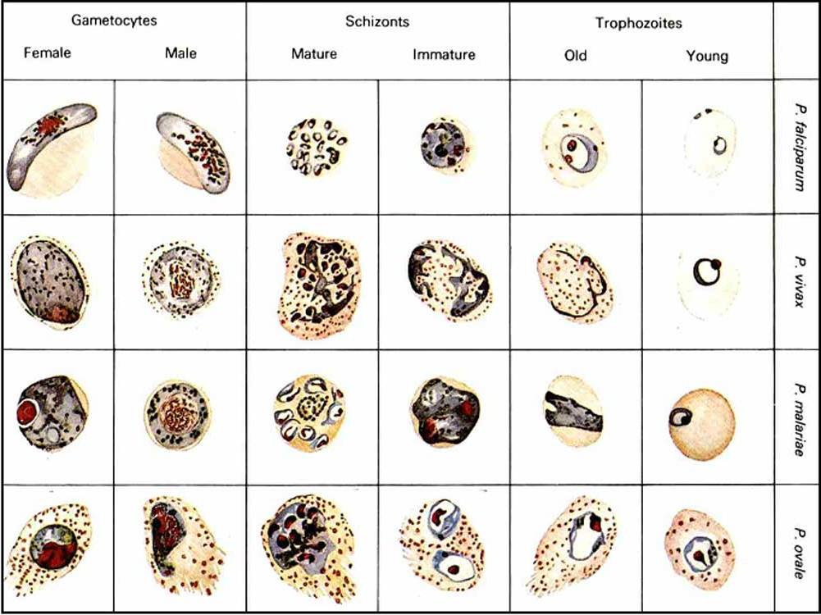
Diagnosis

Slide 14
Diagnosis
Malaria pigments = Haemozoin
It is the remnants of haemoglobin that was digested by parasite
Schuffner’s dots
Ziemann’s dots
Called: Stippling
Maurer’s clefts
It is degeneration process occurring in Plasmodium infected RBCs
C
2- Detection of circulating parasite antigen using monoclonal antibodies.
T
3- Detection of parasite DNA and RNA in patient’s blood using DNA and RNA probes.

Slide 15
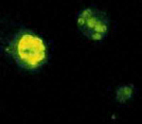
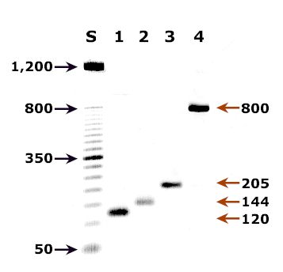
Diagnosis
Po
Pm
Pf
Pv
4- Quantitative Buffy Coat (Q.B.C.):
Blood is collected in capillary tube coated internally with fluorescent dye & centrifuged >> Plasmodium parasitized cells accumulate below WBCs and platelets (buffy coat layer) >> examined under fluorescent microscope >> stained malaria parasites appear brilliantly green.
Malaria PCR

Slide 16
Treatment
Antimalarial drugs are classified according to the affected life cycle stage:
Tissue Schizonticidal drugs:
act on tissue stage in the liver
(a)- Pyrimethamine (Daraprim) or Proguanil.
(b)- 8 aminoquinolines (Primaquine).
2. Anti-relapse tissue Schizonticidal drugs:
act on hypnozoites
8 aminoquinolines (Primaquine)

Slide 17
Treatment (Cont.)
3. Blood Schizonticidal drugs:
act on asexual erythrocytic stages
(a)- 4 aminoquinolines (Choloroquine or Amodiaquine).
(b)- Quinine. (c)- Mefloquine. (d)- Artimesinine.
4. Gametocidal drugs:
Destroy all sexual forms (gametocytes) in blood
8 aminoquinolines (Primaquine).
5. Gametostatic drugs:
Inhibit the transformation of gametocytes into oocysts and sporozoites in midgut of mosquitoes.
(a)- 8 aminoquinolines (Primaquine)
(b)- Pyrimethamine or Proguanil

Slide 18
Treatment regimen of malaria
1- Clinical cure:
to eradicate the red cell stages
A - Quinine sulphate:
650 mg / 3 times / day for three days.
B- Chloroquine (4 amino-quinoline):
600 mg orally, followed after 6 hours by 300 mg then 300 mg / day for 2 days (on 2nd&3rd days).

Slide 19
Treatment regimen of malaria (cont.)
2- Radical cure:
The drug used to eradicates the 2nd tissue phase [prevent relapse]
Primaquine (8 amino quinoline):
15 mg / day for 14 days.
Must be given with or immediately after chloroquine therapy.

Slide 20
Treatment regimen of malaria (cont.)
3- Causal prophylaxis
Drugs that affect the primary tissue phase & are taken by
healthy persons entering a malaria endemic area.
a) Daraprim: 25-50 mg once every week during exposure period.
b) Chloroquine: 300 mg orally a week
[a week before entering the area and continued for 6 weeks after leaving the endemic areas].
c) Fansidar: [25 mg pyrimethamine + 500 mg sulfadoxine]; given as one tablet/week.
d) Proguanil: 100 mg once / day or 300 mg once / week.

Slide 21
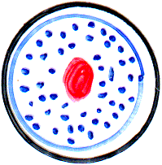
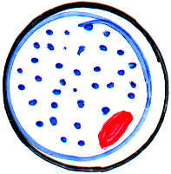
Treatment (in conclusion)
Tissue Schizonticidal: pyrimethamine or Primaquine.
Blood Schizonticidal: Choloroquine or Mefloquine.
Blood gametocytes: Choloroquine or Primaquine.
Recommended regimen for malaria treatment:
During clinical attack: Choloroquine.
Radical treatment after clinical attack: Primaquine.
( P.vivax and P.ovale )
Treatment of drug resistant cases: drug combination as Coartem (artemether and lumifantrine).
Chemoprophylaxis for healthy human entering an endemic area: pyrimethamine or Primaquine.
Choloroquine or Mefloquine.

Slide 22
Epidemiology
1- Infected human (gametocyte carrier).
2- Suitable species of Anopheles mosquito vector.
3- Human (susceptible to infection).
Duffy antigen
merozoite
Humans resistant to malaria infection
- Absence of Duffy blood-group antigen.
Resistant to P.vivax infection.
- Haemoglobin S (in sickle-cell disease)
Shape of RBC and type of Hb are not suitable for P.falciparum parasite growth.
- Deficiency of G6PD enzyme.
P.falciparum parasite needs this enzyme for its growth.

Slide 23
Epidemiology
Anopheles mosquitoes: species of anopheles present in the
area influence the intensity of transmission.
The females that prefer to feed on humans indoors will be
more effective vectors.
Insecticide resistance is an important factor
Biological characteristics influence a person’s malaria risk
Two genetic factors are epidemiologically important: 1) persons who have the sickle cell trait heterozygotes for the abnormal hemoglobin S are resistant; 2) Persons who are negative for the Duffy blood group have RBCs resistant to infection by P. vivax.
Pregnancy: women who have developed protective immunity against P. falciparum tend to lose this protection if pregnant
Behavioral factors:
housing, use of bed nets, financial situation, standing water, agricultural work, war migrations….. etc

Slide 24
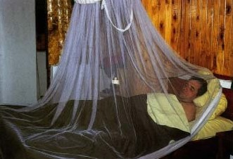
Control
Treatment of cases.
Mosquito control.
Chemoprophylaxis.
Vaccination trials:
The problem is antigenic variation.
A synthetic vaccine with separation of the gene responsible for antigenic variation.

Slide 25
State true or False
Recrudescence of malarial attacks are due to reactivation of dormant hypnozoites in liver cells.
False
Recrudescence of malarial attacks are due to flaring up of parasitaemia.
Black water fever is due to glomerulonephritis complicating infection with Plasmodium malariae.
False
Black water fever is due to intravascular haemolysis complicating infection with Plasmodium falciparum.

Slide 26
M.C.Q.
In malaria, Sporogony occurs in:
a- Human RBCs
c- Female Anopheles
b- Human liver cells
d- Cerebral blood vessels
Adherence of the parasitized red cells in P.falciparum infection is the cause of:
a- black water fever
c- malarial recrudescence
b- cerebral malaria
d- malarial relapse
Pathogenesis of vivax malaria is mainly due to:
a- Persistence of hypnozoites in the liver.
b- Rupture of hepatocyte & release of Schizont content.
c- Rupture of RBCs & liberation of pigment & parasite products.
d- Formation of gametocytes in blood stream.

Slide 27
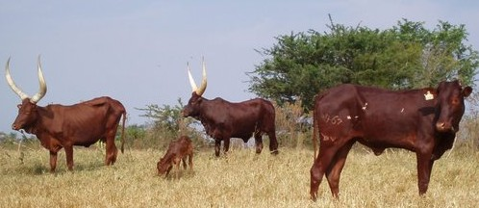
Babesia species
Causes: Babesiosis
Geographical Distribution: North and South America and Europe.
Babesia is an animal parasite that causes
Texas cattle fever.
It affects humans in contact with animals.
Hard tick القراد

Slide 28
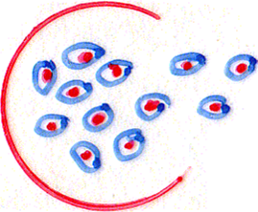
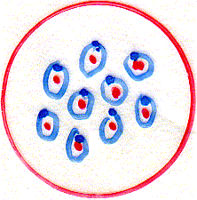
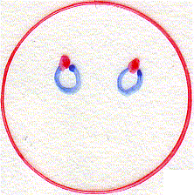
Mode of Infection
Through the bite of hard ticks.
Through blood transfusion.
Rupture
Hard tick
Sporozoites infective stage
budding
merozoites
Rings diagnostic stage

Slide 29
Pathogenesis and Clinical Picture
Asymptomatic.
Malaria-like picture with haemolytic anaemia but NO periodicity.
Fulminant disease that may end fatally in: Splenectomized OR Immunodefficient patients
Babesia is an opportunistic protozoan

Slide 30
Diagnosis
1- Blood film
2- Serology
3- PCR
Multiple small rings No malaria pigment
Treatment
Clindamycin + Quinine
Prevention and Control
Measures to control ticks

